Slide 1
Agent Based Modeling of Herds and Spatial Metrics for Animal Movement
Beth Johnson
johnsel@math.umd.edu
Advisor:
Dr. Bill Fagan
Department of Biology
bfagan@umd.edu

Slide 2
Background
Background
There are many different mechanisms that animals may use to direct movement
  Non-oriented – random movement
  Oriented – movement directed by a stimulus (visual observation of food)
  Spatial memory – uses previous information, passed through individuals or generations
Animals may use more than one or all three movement mechanisms
No current movement theory to unify all three mechanisms

Slide 3
Background
Background
There are three different population level distributions that animals exhibit
  Sedentary ranges – individual occupies relatively small area compared to population range
  Migration – regular movement to and from spatially disjoint ranges
  Nomadism – does not follow regular temporal and spatial patterns
Need a way to evaluate and qualify dispersion patterns at the population level that does not rely on an assumption of one of these three types of distributions

Slide 4
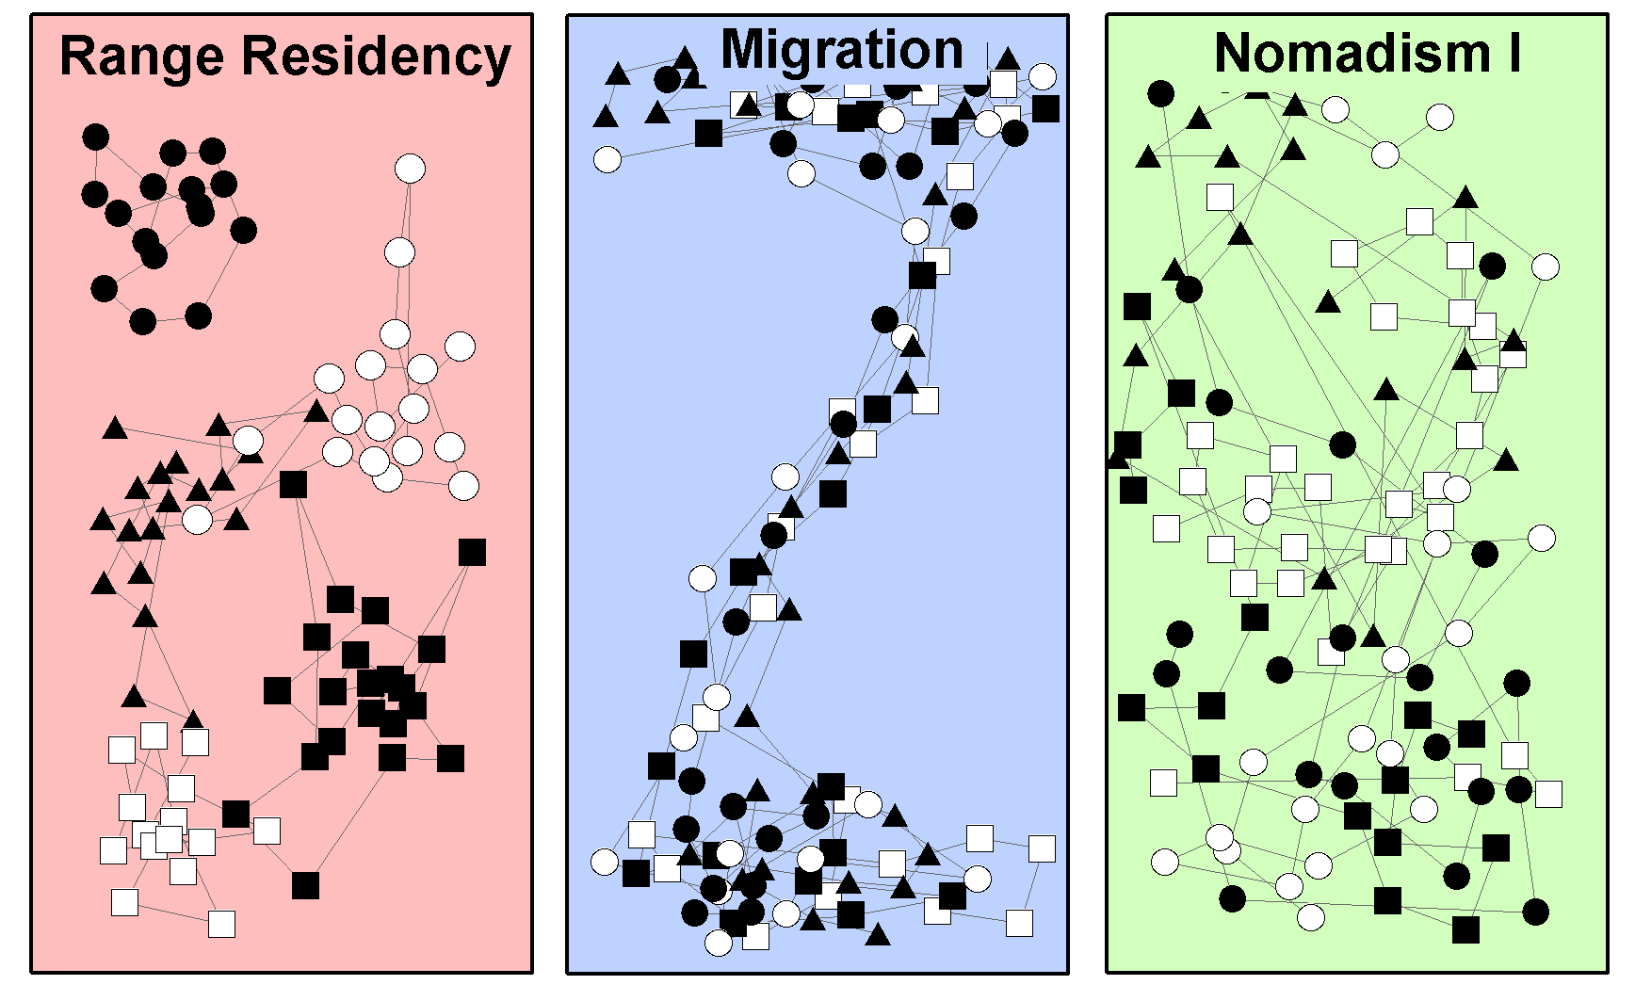
Background
Background
Mueller, Thomas, and William F. Fagan. "Search and navigation in dynamic environments–from individual behaviors to population distributions." Oikos 117.5 (2008): 654-664.

Slide 5
Approach – ‘Evolve’ an Agent Based Model with ANN
Background
Fix landscape variability
Evolve agents for landscape (stage 1)
Create herd from best agent
(stage 2)
Determine spatial statistics
Realized Movement Index
Population Dispersion Index
Movement Correlation Index
Gazelle Relocation Data

Slide 6
Landscape Variability
Patch size
1
75%
Predictability
generations
50%

Slide 7
Landscape - Validation
Landscape
Landscape generation code run for 5000 generations, recording number of resources per patch (all landscape combinations)
Uniform Distribution of resources, except where patches of resources (red) or empty patches (blue) declared stable

Slide 8
Evolve agents for landscape
Set landscape
Select random starting location
Allow agent i to move 1 step across landscape
Stage 1
for 1:time steps
Randomly initialize weights of agents
Record resources, update landscape
for agents i < N
Create 6 copies of that agent
(with mutation + crossover)
Find agent with most resources
Randomly select 6 agents
Until all agents selected

Slide 9
Agent Movement
Mechanism
Input Layer
Hidden Layer
Output Layer
Bias
non-oriented
Resource Uptake (total)
1
5
Stage 1
Resource Uptake (last 8 steps)
Search Effort
2
4
oriented
Resources in 8-cell neighborhood
spatial memory
Current x location
Current y location
3
6
Step counter
Inputs are scaled to be [-1,1], values at hidden and output nodes determined by the following, where weights are integers [-5,5]
Mueller, Thomas, William F. Fagan, and Volker Grimm. "Integrating individual search and navigation behaviors in mechanistic movement models.” Theoretical Ecology 4.3 (2011): 341-355.

Slide 10
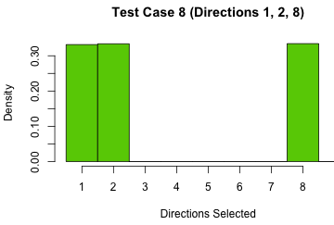
Agent Movement - Validation
Set test agents with specific genes (weights) and landscapes, with particular attention to edges and corners
Stage 1
Node | Value
Output Node 4 | 0.267
Output Node 5 | 0.484
Output Node 6 | 0.055
Let agent choose direction 5000 times
Create histogram
Compare with known allowed directions

Slide 11
Reproduction - Validation
Set crossover and mutation probability to zero – graph of efficiency vs. generation should have a sharp increase and then flatten after a few generations
Stage 1
Patch Size: 4x4
Predictability: 50%
Generations: 300
Green:
Mutation: 0%
Crossover 0%
Blue:
Mutation: 2% Crossover: 20%
Average Resources Encountered
Per Times Step
Generation

Slide 12
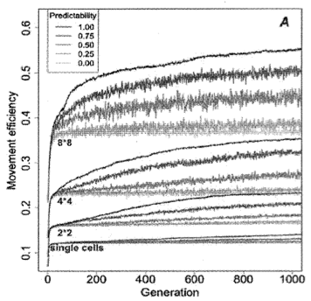
Stage 1 - Validation
Compare overall trends (10 runs of each landscape) to results from Mueller et al. (100 runs of each landscape)
Stage 1
Mueller, Thomas, William F. Fagan, and Volker Grimm. "Integrating individual search and navigation behaviors in mechanistic movement models."Theoretical Ecology 4.3 (2011): 341-355.

Slide 13
Stage 1 - Timing
Originally, all of Stage 1 was implemented in R, but the average time per generation (~16 seconds) was too slow to be feasible for the 10x1,000x20 = 200,000 generations to create plot on previous slide
Stage 1 was then implemented in MATLAB, with an average time per generation of ~2 seconds, allowing 10 runs of each landscape for 1000 generations in about 4.6 days
Time is highly dependent on number of agents (240 in all simulations)
Stage 1

Slide 14
Stage 2
Keep agent with max resources and save landscape after 1000 generations
Create 24 perfect copies of agent and generate landscape according to predictability + patch size (initial resource count in each cell is 24)
Agent movement rules are same as Stage 1, with the exception that agents cannot occupy the same cell
Update each agent at a particular time step in a random order
Stage 2

Slide 15
Stage 2 - Validation
Only large change from Stage 1 is new movement rule – create more test cases focusing on when other agents occupy surrounding cells
x
Stage 2
Node | Value
Output Node 4 | 0.267
Output Node 5 | 0.484
Output Node 6 | 0.055

Slide 16
Stage 2 – Data Generated
From Stage 2, 80 sets of simulated relocation data were generated - 20 landscapes, 4 data sets per landscape:
  Full data set: 24 agents, 150 (x,y) locations
  Half data set: 24 agents, 75 (x,y) locations, created by taking every other point from full data set
  Fifth data set: 24 agents, 30 (x,y) locations, created by taking every 5th data point from full data set
  Tenth data set: 24 agents, 15 (x,y) locations, created by taking every 10th data point from full data set
All data sets exported to .csv file with ID #, x, y
Stage 2

Slide 17
Stage 2 – Data Generated
Stage 2
Patch: 8x8 Predict: 100%
Patch: 4x4 Predict: 100%
Patch: 4x4 Predict: 0%
Patch: 4x4 Predict: 100%

Slide 18
Realized Mobility Index
Describes how much of the annual population range an individual was using
RMI is ratio of area of polygon for individual to the area of the polygon for the population
RMI

Slide 19
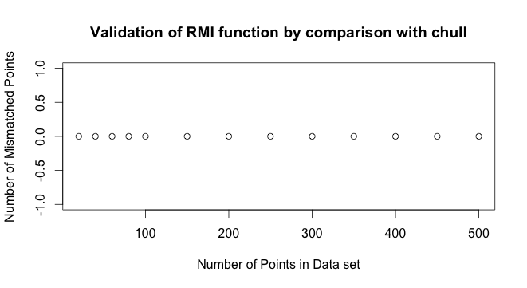
RMI - Validation
Generate data sets of differing point sizes and compare with built in R function, chull
All hulls were exactly the same
RMI
R Core Team (2013). R: A language and environment for statistical computing. R Foundation for Statistical Computing, Vienna, Austria. URL http://www.R-project.org/.

Slide 20
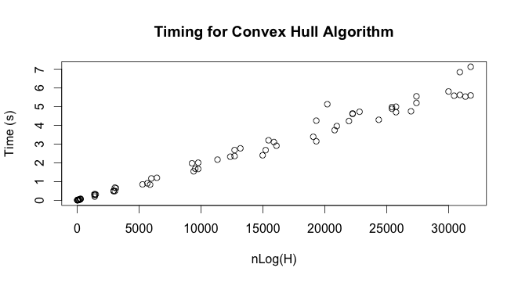
RMI - Timing
Theory says should find convex hull in nlog(H) time, where H is the number of points on the hull
RMI

Slide 21
Movement Correlation Index
Assume movements are described by discrete time based Gaussian position jump process, N individuals, M steps
Impose global mean (μ_{x}, μ_{y}), global variance (σ²), and global correlation (ρ) on all individuals
Use maximum likelihood to estimate parameters
Interested in position correlation (ρ)
MCI
Calabrese, Justin, Chris H. Fleming, Bill F. Fagan, Marin Rimmler, Petra Kaczensky, Peter Leimgruber, and Thomas Mueller. From the fish tank to the Gobi desert: A general, scalable approach to quantifying animal movement coordination. (2013)

Slide 22
Movement Correlation Index
Want to maximize
Closed form solution exists
MCI
N x N
N x 1
N x 1
Calabrese, Justin, Chris H. Fleming, Bill F. Fagan, Marin Rimmler, Petra Kaczensky, Peter Leimgruber, and Thomas Mueller. From the fish tank to the Gobi desert: A general, scalable approach to quantifying animal movement coordination. (2013)

Slide 23

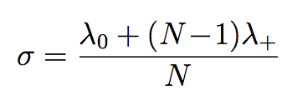
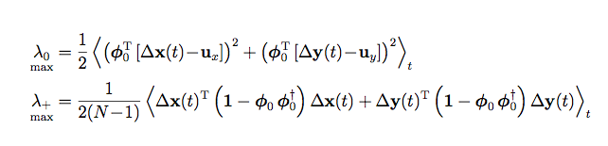

Movement Correlation Index
Closed form solution
MCI
Calabrese, Justin, Chris H. Fleming, Bill F. Fagan, Marin Rimmler, Petra Kaczensky, Peter Leimgruber, and Thomas Mueller. From the fish tank to the Gobi desert: A general, scalable approach to quantifying animal movement coordination. (2013)

Slide 24
MCI - Validation
Movement Correlation Index describes how much individual movements were correlated with other individuals movements
Useful for consideration with other metrics, but the code is very simple (10 lines)
Validated by hand computation
MCI

Slide 25


Population Dispersal Index
PDI describes how clustered the individuals are at different spatial scales
For each individual, compute the bivariate k function at distance s (expected value of points in Pattern 2 distance s from Pattern 1)
  Pattern 1 is the points for individual, # points m₁
  Pattern 2 is the points for entire population minus the individual, # points m₂
PDI
This function cycles through every point in pattern 1 and counts points in pattern 2 that are within distance s or less.

Slide 26

Population Dispersal Index
s
PDI

Slide 27
Population Dispersal Index
W(p₂,p₁) = .8
If the point is outside distance s, do not count it. If it is inside distance s, count it, but account for edge effects.
W(p₁, p₂) = 1
PDI
W(p_{i},p_{j}) is the fraction of the circumference of the circle (centered at p_{i} crossing through p_{j}) within the total population boundary.

Slide 28
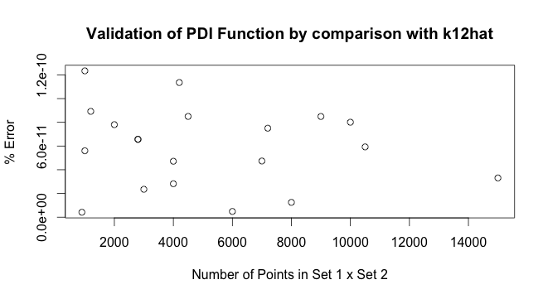
PDI - Validation
PDI was validated by comparison with the k12hat function in the R library Splancs
Data sets of varying sizes were generated by drawing points from uniform distribution
PDI
Rowlingson, Barry and Peter Diggle (2013). splancs: Spatial and Space-Time Point Pattern Analysis. R package version 2.01-34. http://CRAN.R-project.org/package=splancs

Slide 29
PDI - Timing
PDI fully implemented in R was too slow to be feasible for simulation data sets (black circles)
Final implementation was in C with an R wrapper (blue +)
  (approx 6000x faster)
PDI

Slide 30
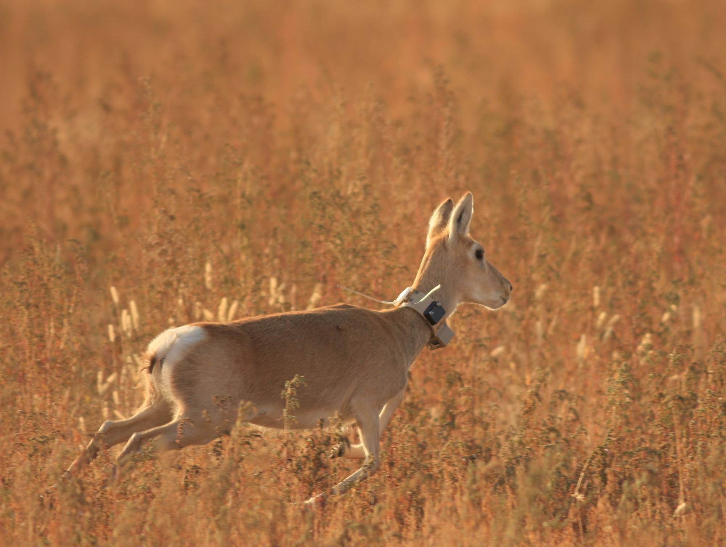
Testing – Spatial Statistics
80 simulation data sets
Gazelle data
  36 individuals, x and y position data at various times (1 to 25 hour intervals) ranging from 50 to 978 days total
Testing

Slide 31
Testing – RMI for Simulation
Testing

Slide 32
Testing – RMI for Simulation
Testing

Slide 33
Testing – RMI for Simulation
Testing

Slide 34
Testing – RMI for Simulation
Testing

Slide 35
Testing – RMI for Simulation
Testing

Slide 36
Testing – RMI for Simulation
Testing

Slide 37
Testing – RMI for Simulation
In general, RMI decreases slightly with larger sampling intervals
As patch size decreased, RMI increased
Typically, migratory or nomadic animals would have high RMI, home range would have low RMI
Testing

Slide 38
Testing – MCI for Simulation
Testing

Slide 39
Testing – MCI for Simulation
Small patch sizes and short sampling intervals showed very small MCI
Large patch sizes with long sampling intervals showed a large negative correlation
  Potentially due to random start location
  Potentially due to movement rules
Typically, over long sampling intervals, migratory populations would have large positive correlation and in most other cases, correlation should be small
Testing

Slide 40
Testing – PDI for Simulation
Testing

Slide 41
Testing – PDI for Simulation
Testing

Slide 42
Testing – PDI for Simulation
Testing

Slide 43
Testing – PDI for Simulation
Testing

Slide 44
Testing – PDI for Simulation
PDI values were very similar across differing sample intervals
Increasing PDI (at all values of S) for increasing patch size
In general, higher predictability lead to larger PDI
For home range, PDI should be small as animals typically occupy ranges that may not overlap, and migratory should have large PDI during migratory season
Testing

Slide 45
Testing – Gazelle Data
As absolute position does not matter, scaled gazelle data to have similar scale as simulation
Values similar to that of 1x1 patches for PDI and MCI, lower RMI than all simulations
Metric | Value
MCI | -0.1273
RMI | 0.0751±0.0676
PDI (S=2) | 29.99±14.52
PDI (S=3) | 60.18±26.30
PDI (S=4) | 97.41±40.61
PDI (S=5) | 140.39±56.10
Testing

Slide 46
Conclusions
RMI is fairly robust to sampling interval, but decreases with increasing interval, PDI very robust to sampling interval, MCI varies greatly with sampling interval
Agent based model does not sufficiently capture animal movement as to result in different population level patterns as seen in nature
Conclusion

Slide 47
Further research?
Larger map size
Additional attractive/repulsive forces between animals in the herd
Periodic landscape regeneration
Conclusion

Slide 48
Deliverables
October – Set up data structures for agents, code to initialize landscape and agents
November – Implement and validate genetic algorithm + neural networks
December - Implement stage 1 (evolving agents) create mid year report and presentation
Late January - Implement stage 2 (herd of agents) [occurred in Feb/March]
Feb – Implement RMI, PDI, and MCI
March - Validate overall agent model and spatial metrics
April – Test spatial metrics with gazelle data + simulation data
May – Create final report + presentation, documentation + examples for spatial metrics code
Conclusion

Slide 49
References
Calabrese, Justin, Chris H. Fleming, Bill F. Fagan, Marin Rimmler, Petra Kaczensky, Peter Leimgruber, and Thomas Mueller. From the fish tank to the Gobi desert: A general, scalable approach to quantifying animal movement coordination. (Unpublished, 2013)
Kirkpatrick, David G., and Raimund Seidel. "The ultimate planar convex hull algorithm?." SIAM journal on computing 15.1 (1986): 287-299.
Lotwick, H. W., and B. W. Silverman. "Methods for analysing spatial processes of several types of points." Journal of the Royal Statistical Society. Series B (Methodological) (1982): 406-413.
Mueller, Thomas, William F. Fagan, and Volker Grimm. "Integrating individual search and navigation behaviors in mechanistic movement models."Theoretical Ecology 4.3 (2011): 341-355.
Mueller, Thomas, and William F. Fagan. "Search and navigation in dynamic environments–from individual behaviors to population distributions." Oikos117.5 (2008): 654-664.
Mueller, Thomas, et al. "How landscape dynamics link individual‐to population‐level movement patterns: a multispecies comparison of ungulate relocation data." Global Ecology and Biogeography 20.5 (2011): 683-694.
R Core Team (2013). R: A language and environment for statistical computing. R Foundation for Statistical Computing, Vienna, Austria. URL http://www.R-project.org/.
Rowlingson, Barry and Peter Diggle (2013). splancs: Spatial and Space-Time Point Pattern Analysis. R package version 2.01-34. http://CRAN.R-project.org/package=splancs

